Slide 1
Time Management

Slide 2


Slide 3
What is Time Management?
• Time management is the process of organizing and planning how to divide your time.
• It helps to work smarter, not harder.
• Increases productivity, reduces stress, and ensures goal achievement.

Slide 4

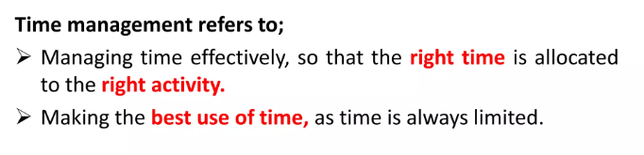
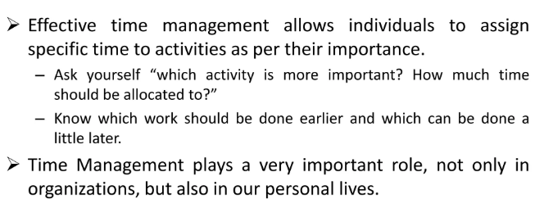

Slide 5
Time management is the process of planning, organizing, and controlling your time to increase effectiveness, efficiency, and productivity by setting goals, prioritizing tasks, and minimizing distractions. Good time management skills are essential for reducing stress, avoiding burnout, improving performance, and achieving both personal and professional goals. Key strategies include daily planning, prioritizing urgent tasks, using productivity tools, eliminating distractions, and maintaining a healthy lifestyle.

Slide 6
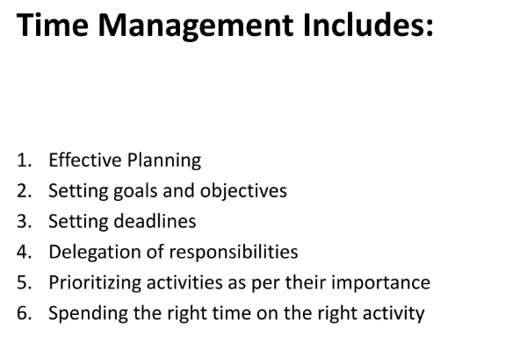

Slide 7
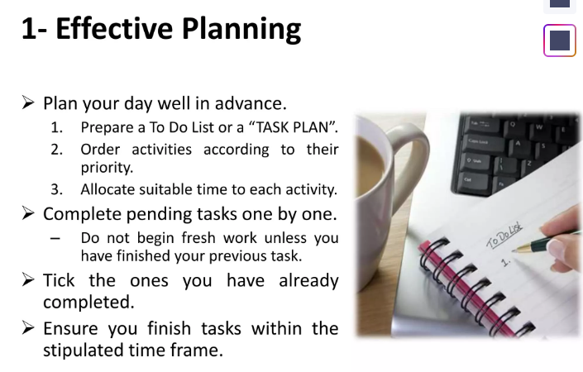

Slide 8


Slide 9
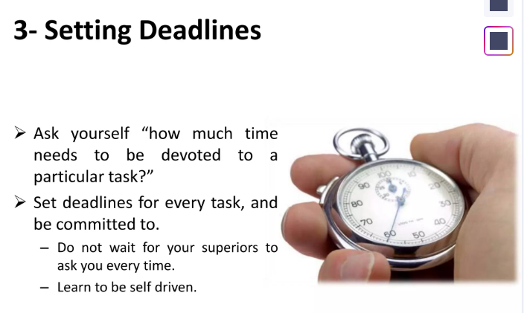

Slide 10
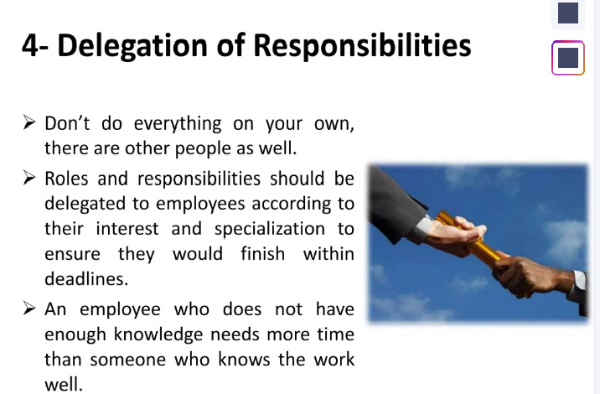

Slide 11
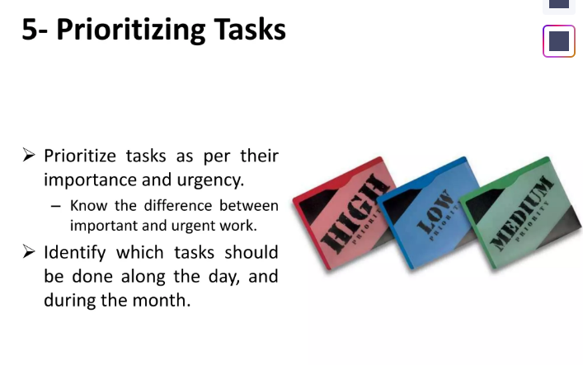

Slide 12
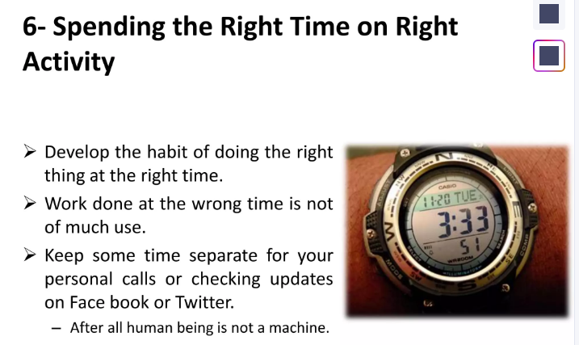

Slide 13
Importance of Time Management
• Helps achieve goals effectively.
• Reduces procrastination.
• Enhances productivity and efficiency.
• Improves decision-making.
• Reduces stress and improves focus.

Slide 14
Why Time Management Is Important
Reduces Stress:
A well-managed schedule helps you feel more in control, leading to less anxiety and stress.
Increases Productivity:
By prioritizing and focusing, you can accomplish more in less time.
Improves Performance:
Good time management allows you to deliver high-quality work and meet deadlines.
Boosts Confidence:
Successfully managing your tasks and time can significantly increase your self-confidence.
Promotes a Balanced Lifestyle:
Effective time management creates space for personal interests, hobbies, and leisure, contributing to a healthier life.

Slide 15
Techniques of Time Management
• Prioritization (Eisenhower Matrix).
• Planning and Scheduling.
• Setting SMART Goals.
• Avoiding Multitasking.
• Using To-Do Lists and Calendars.

Slide 16
Barriers to Time Management
• Procrastination.
• Lack of Prioritization.
• Distractions (phone, social media).
• Poor Planning.
• Overcommitment.

Slide 17
Tips for Effective Time Management
• Plan your day in advance.
• Use the 80/20 rule (Pareto Principle).
• Break large tasks into smaller ones.
• Learn to say NO.
• Take breaks and manage energy.

Slide 18
How to Improve Your Time Management Skills
1. Set Goals:
Establish SMART (Specific, Measurable, Attainable, Relevant, Timely) goals to provide a clear direction for your efforts.
2. Prioritize Tasks:
Create a to-do list and identify urgent and essential tasks, completing them before less important ones. Techniques like the 4 Ds of Time Management (Do, Defer, Delegate, Delete) can help categorize tasks.
3. Plan Your Day:
Start each day with a brief meeting to review your to-do list and plan out what you will work on.
4. Minimize Distractions:
Turn off notifications, use website blockers, or create dedicated time slots for checking emails to stay focused.

Slide 19
How to Improve Your Time Management Skills
5. Use Planning Tools:
Employ calendars, to-do lists, or apps to record and track your tasks and deadlines.
6. Lead a Healthy Lifestyle:
Regular exercise and a healthy diet can increase your energy levels, enhancing your ability to concentrate and complete tasks.
7. Practice Awareness and Adaptation:
Be mindful of how you spend your time, structure your days effectively, and be prepared to adjust your schedule as needed.

Slide 20
The 5 Ps of time management
:
1. Prioritize:
Focus on the most important tasks first, using methods like the Eisenhower Matrix to distinguish between urgent and important.
2. Plan:
Organize your tasks and activities in advance by creating a schedule or to-do list.
3. Prepare:
Get ready for tasks by gathering necessary information, tools, or resources before starting.
4. Pace:
Manage your time and energy effectively by taking breaks when needed and not overworking, ensuring you maintain focus and stamina.
5. Persist:
Maintain motivation and follow through on your plans, even when facing challenges or delays, to ensure tasks are completed.

